Slide 1
Android OS
Week 14 - Lecture

Slide 2

Agenda
What is Android
History of Android
Design Goals
Android Architecture
Linux Extensions
Dalvik
Binder IPC
Android Applications
Application Sandboxes
Security

Slide 3

What is Android?
Operating system for smartphones & tablets
Based on Linux kernel
Open source software (AOSP)
Best-selling OS since 2013

Slide 4

History of Android
Company & OS evolution

Slide 5





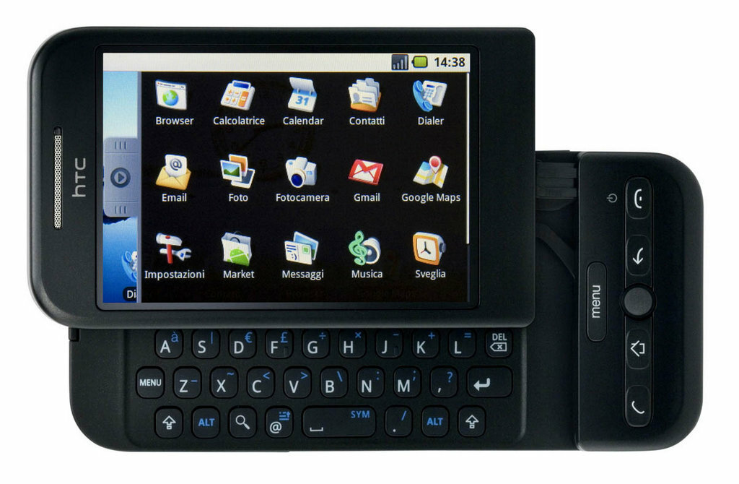
Android and Google
(startup) Android, inc. switched from cameras to smartphones
Targeting JavaScript, Java, C++
Acquired by Google in 2005
Focused on Java in 2006
Android 1.0 Dream in 2008

Slide 6
















OS Evolution
Cupcake
1.5
Donut
1.6
Eclair
2.0/2.1
Froyo
2.2
Gingerbread
2.3
Honeycomb
3.0/3.1
Ice cream sandwich
4.0
Jelly bean
4.1-4.3
Kitkat
4.4
Features:
Android RunTime with AOT instead of JIT Dalvik
Project Volta (battery)
Standard dock
Voice actions
Adobe Flash
Holo interface with Roboto
Face unlock support
Lock screen apps
Third-party virtual keyboards
Widgets
Auto-rotation
USB-C
4K mode
App permissions rework
Lollipop
5.0
Marshmallow
6.0
Nougat
7.0
Oreo
8.0
Pie
9.0
Q
10.0
?
11.0

Slide 7






Design Goals
Open Source OS for mobile devices
Support third-party apps & allow them to compete on market
Provide sufficient security : no need to trust apps
Support smartphones use cases: quick check of many apps
Manage applications for the user

Slide 8
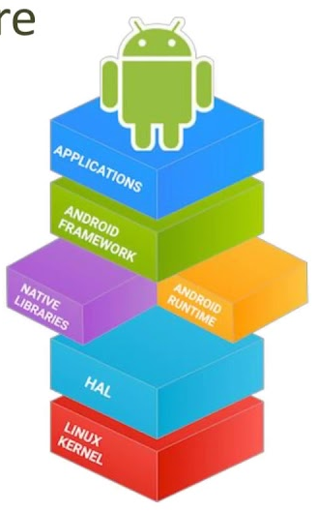
Android Architecture
Internal building blocks of Android

Slide 9
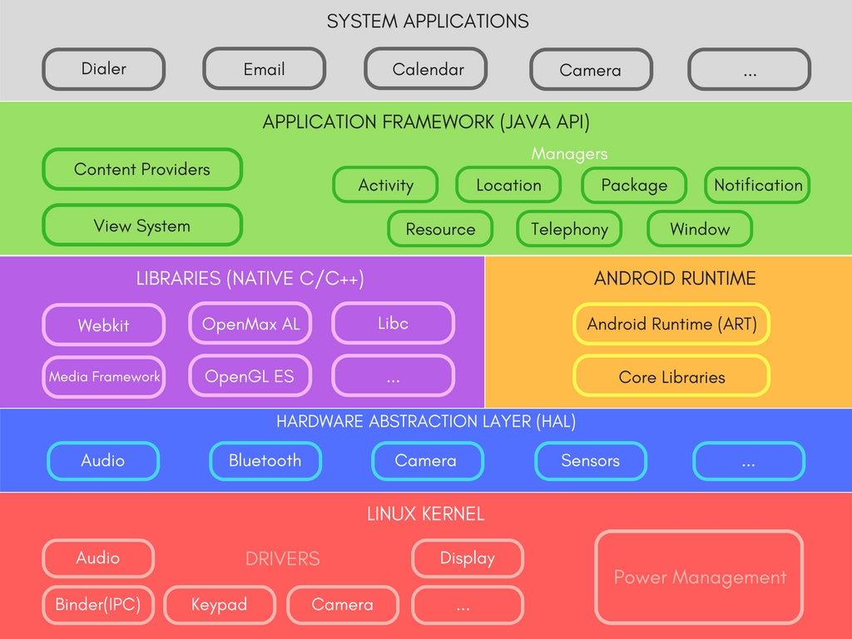

Software Stack of Android
Collection of APIs in Java
Gives developers access to the complete feature set of Android, same as core apps use
Building blocks for your app with core components and services including:
Activity Manager
Window Manager
Content Providers
View System
Package Manager
Notification Manager
Android Systems components largely use native C/C++ libraries
They are exposed through Android Application Framework (Java API)
Examples:
SQLite for data storage
OpenGL for 3D graphics
WebKit for web browsing
HAL – Hardware Abstraction Layer
Standard interfaces that expose device hardware capabilities to Java API
HAL has multiple library modules, each implementing interface of some component, like camera or Bluetooth
ART – Android RunTime
Available from 5.0 (API level 21) – Dalvik was used before
Run apps in constrained environment
DEX – bytecode designed specially for Android to manage memory efficiency
Core libraries for Java development
Efficient garbage collector
Basic system apps: email, calendar, camera, etc.
Third-party apps can be made default apps: custom keyboard or web browser
System apps are both apps for users and interfaces for developers (no need to implement SMS on your own)
Android follows layered approach
6 components, different roles
Foundation of Android is Linux Kernel with few extensions
Developers do not have to write it themselves
Key functionalities:
Threading and low-level memory management
Power management, IPC
Direct access to hardware via drivers
Libraries & APIs in C/C++
Android Framework Service
Sensor HAL
Linux Device Driver

Slide 10

Linux Extensions
Power management
IPC Binder
Low Memory Killer
Ashmem
RAM Console and Log Device
Android Debug Bridge (ADB)
Kernel extended for mobile needs

Slide 11
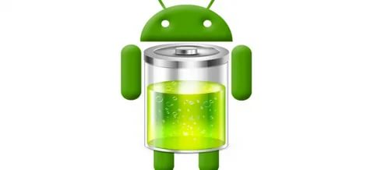
Power Management
Build on top of Linux Power Management (PM)
Mobile everyday use cases differ a lot from computers, users have different expectations: ‘screen of’ != ‘true sleep’
Linux provides such functionality: make CPU idle. Not the best solution, however
Wake locks are introduced to keep power

Slide 12

Power Management: Wake Locks in Action
App
Power Manager
PM Driver
Wl.release
Release wake lock
pm.newWakeLock
Create wake lock
Wake lock set
CPU sleeps!

Slide 13
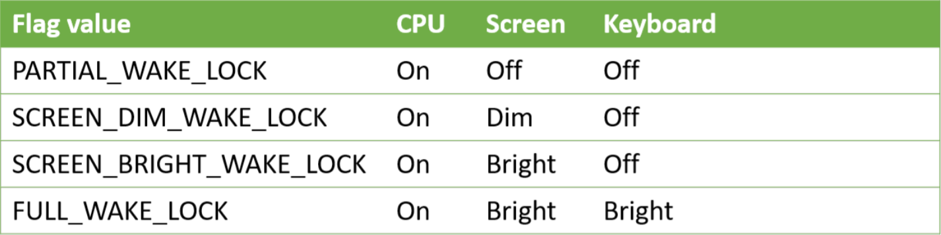
Power Management: Code Example
...
PowerManager pm = (PowerManager) mContext.getSystemService(Context.POWER_SERVICE);
PowerManager.WakeLock wl =
pm.newWakeLock(PowerManager.SCREEN_BRIGHT_WAKE_LOCK, "MyWakeLock");
wl.acquire();
// do something
wl.release();
...

Slide 14
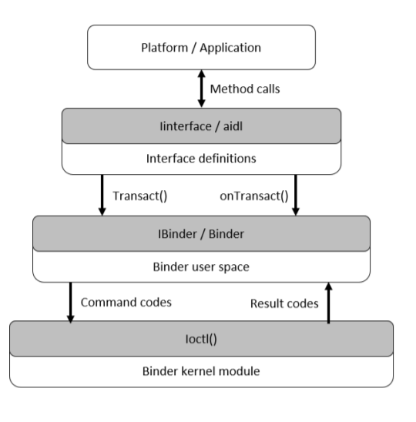
Binder IPC
There are a lot of processes communicating with each other
One need a powerful mechanism to organize communication
Binder InterProcess Communication is a rich general-purpose IPC in Android

Slide 15
Binder IPC
3-layer structure:
Kernel module for actual communication. Uses ioctl() general-purpose kernel call
Object-Oriented Binder user space. Allows apps to communicate through IBinder interface and Binder class
Interface-based high-level model for apps. They declare they communication interfaces and don’t worry about lower-level details

Slide 16
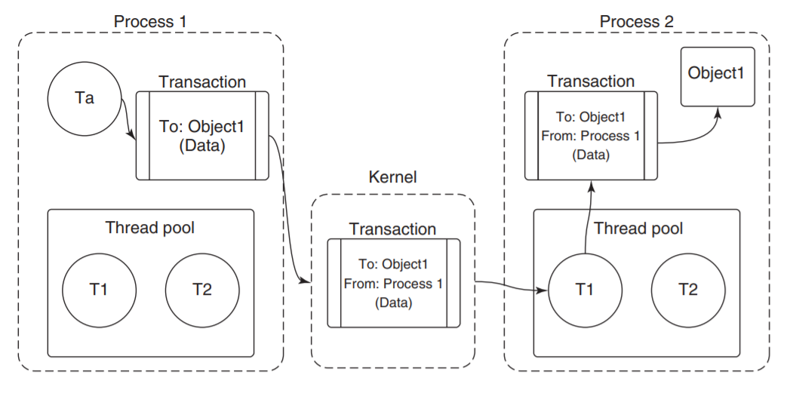
Binder IPC
Binder uses RPC – remote procedure call – that is submitting complete IPC operation to the kernel. It is then executed in receiver.
Binder IPC is message-based, not stream-based like Linux pipes
Message is called Transaction – function across processes

Slide 17
Binder IPC
User-space apps do not interact with kernel module directly
Object-Oriented library with simpler API is provided in form of:
IBinder – interface for Binder object. Transact() – submit operation to the object
Binder object. Other processes can call it, and reply is in key onTransact() method
Parcel – container for read/write in transactions. Not only ints, but references to IBinder for IPC

Slide 18
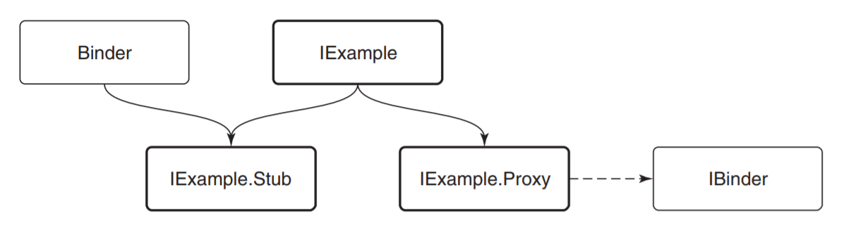
Binder IPC
High-level module, where we are to think about interfaces and methods only
AIDL – Android Interface Definition Language
It takes abstract description of an interface and generates source code for it

Slide 19

Low Memory Killer
LMK(or Out-Of-Memory Killer) – tries to recover from low RAM situations
Android has no swap space, standard Linux OOM fails to work well
Assigns each process ‘badness’ level, kill the most bad. Goal: kill largest and unimportant one
Example: kill background calculator, not foreground phone call

Slide 20

Ashmem
Ashmem = Anonymous SHared MEMory
Exists in kernel space as a driver
Ashmem allows processes which are not related by ancestry to share memory maps by name, which are cleaned up automatically.

Slide 21
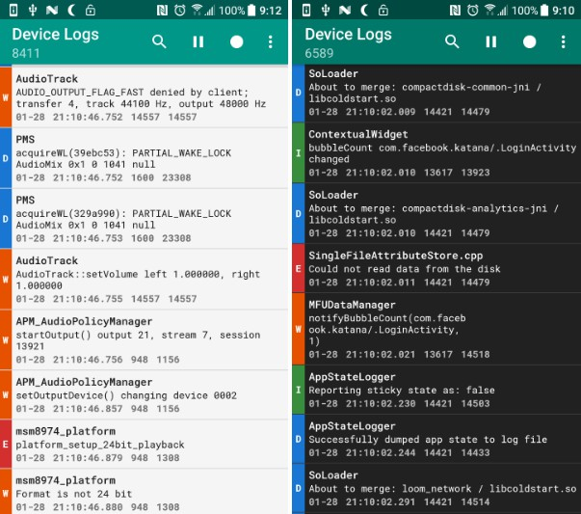
RAM Console and Log Device
RAM Console: logs kernel messages to buffer in RAM for developer’s needs (debug in case of crash)
Log Device – general systemwide logging. 4 Logging buffers
Provides possibility to read and write logs for all kinds of apps

Slide 22
Android Debug Bridge (ADB)
Android Debug Bridge is a command-line tool for communication with a device.
Runs as a background process over USB (or WIFI, lately)
Allows developer to send commands to device, install external apps, use hidden features and more
Communication is organized with 3 participants: client (PC), adbd (Android daemon), server (PC)

Slide 23
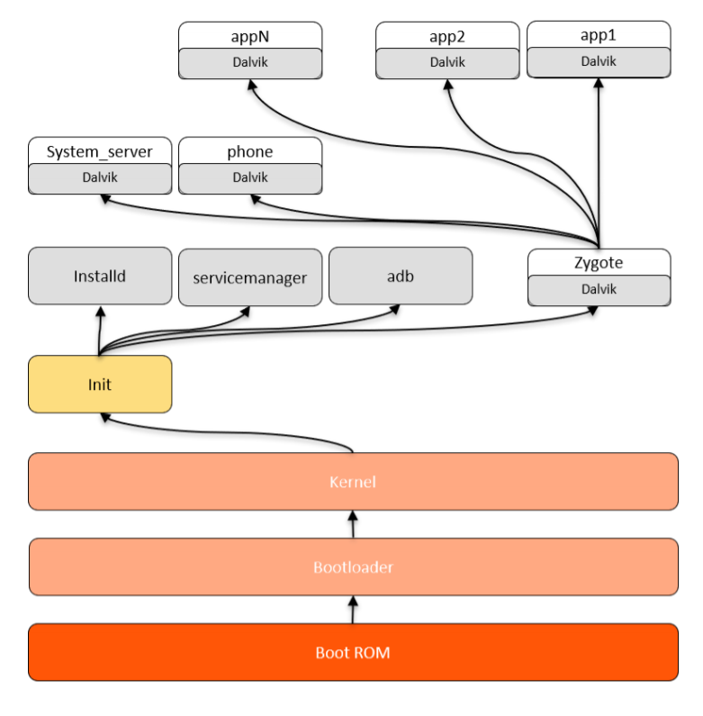
Android boot & process hierarchy
Android architecture tree

Slide 24
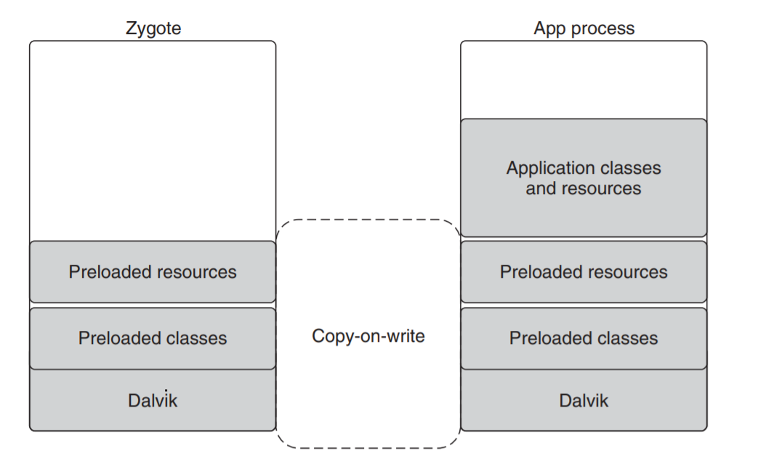
appN
app2
app1
System boot process
Dalvik
Dalvik
Dalvik
Each new process is a child of Zygote and includes VM
So when process starts, Zygote is forked and new VM is created. New app is bound to thread this forked process
Init is the first user-space process
Runs a lot of low-level and background processes
Mounts /dev, /sys, /proc
‘init.rc’ provides generic initialization instructions for apps (start, setprop, ..)
‘init<machine name>.rc’ – same, but hardware-specific
Zygote – daemon that start important core daemons and user apps
First process zygote starts is system_server – all core services are inside it (power manager, packer manager, etc.)
Other processes are created from zygote as needed. ‘‘persistent” ones such as the phone
Additional – when user starts them
Boot ROM code section is executed on start (power button)
Is contained in hardcoded, predefined location
Loads Bootloader to RAM and executes it
Bootloader – piece of code running before any other part of OS
Two main goas:
Detect RAM
Set up minimal environment for OS to start
Also verifies integrity of the boot & recovery partitions
Initialization of Android Kernel is similar to Linux one
Set up cache, protected memory
Mount file system
Starts kernel daemons
Schedule drivers
After these activities, kernel finds ‘init’ process in file system and starts it up
Installd – receive and accomplish requests from Package Manager service. It also installs APK(Android PacKage) with root permissions
Servicemanager – manages all Binder services in the system
Adbd – manages communication via adb
System_server
phone
Dalvik
Dalvik
Zygote
Installd
servicemanager
adb
Dalvik
Init
Kernel
Bootloader
Boot ROM

Slide 25
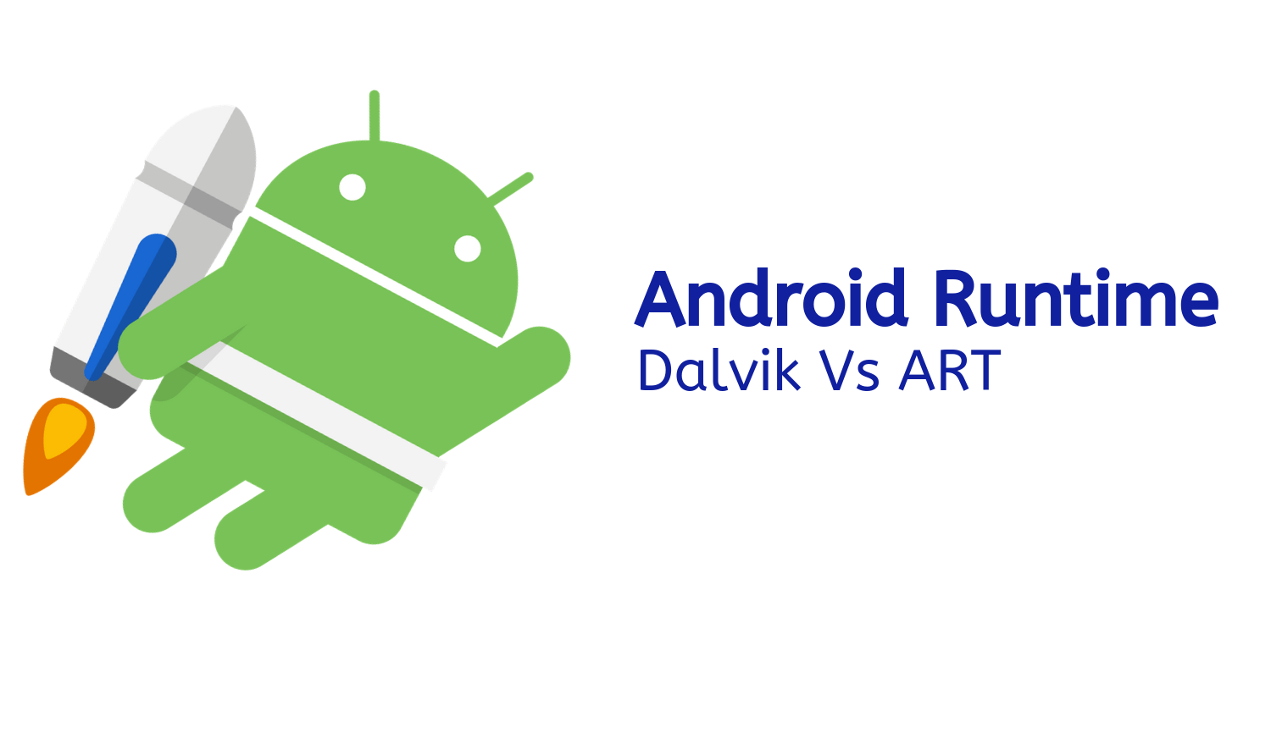
Dalvik & Android RunTime
Review and comparison

Slide 26
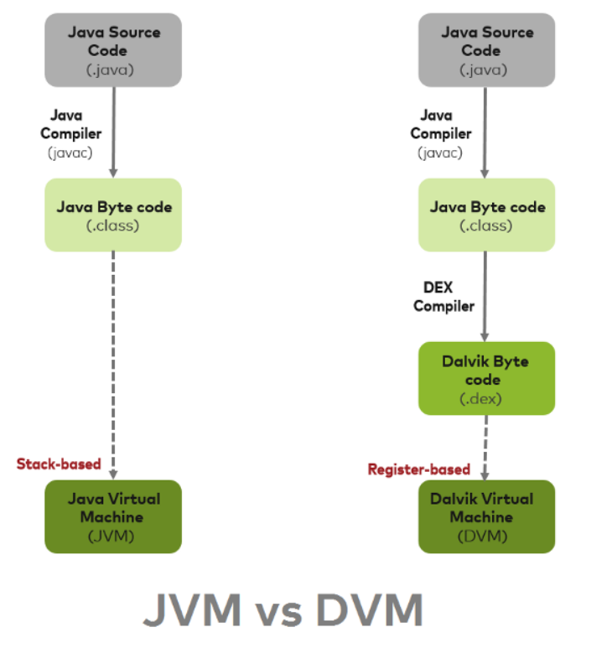
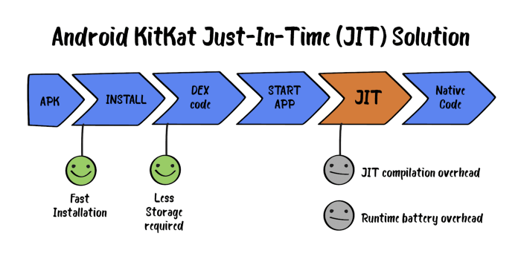
Dalvik
Android versions under 4.4 used Dalvik Virtual Machine (DVM)
Each process is run in isolated address space on register-based DVM
Features:
JIT compilation
Less memory requirements
Multiple VM at once

Slide 27
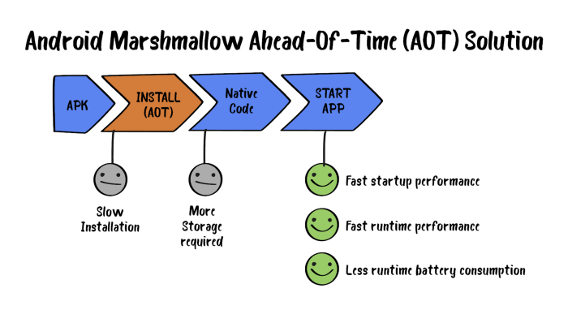
Android RunTime
ART – modern (Android 5.0 and higher) runtime for apps
AOT compilation
Takes more storage & time in installation
Boosted performance while running apps
Improved garbage collector

Slide 28
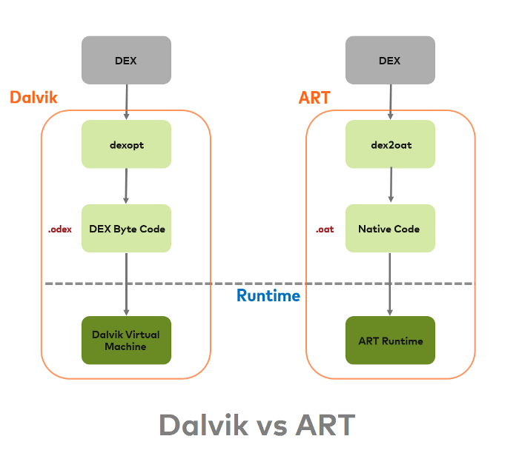
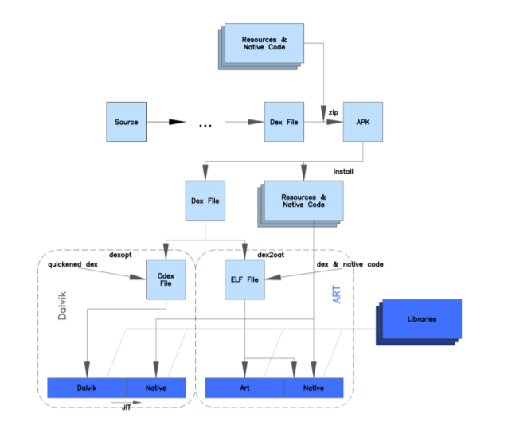
Comparison

Slide 29

Android applications
We’ll finish soon!
Manifests, Activities, Services, Requests and more..

Slide 30

Android App
Android app = ‘.apk’ file by convention
It’s not an executable file with entry point, but container for all info about app:
Manifest – describes what app does and how it runs
Recourses for app
Code for app
Signing information of the author

Slide 31
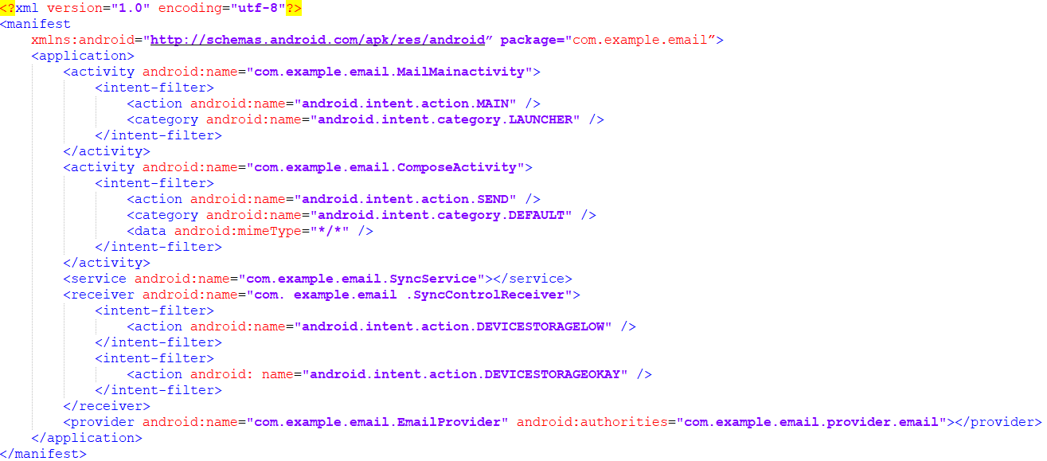
Manifest example

Slide 32

Package manager
This manager (process indeed) exists for retrieving various kinds of information related to the application packages that are currently installed on the device
Parses manifests and gets information
Is capable of answering queries about installed apps and checking APK integrity

Slide 33
Application components
An Android application is composed of 4 main components:
Activities.
Services
Receivers
Content providers.
Let’s discuss all of them one by one!

Slide 34
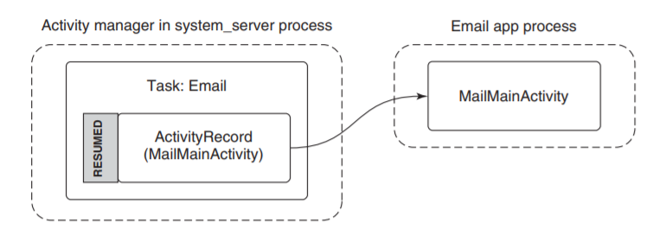
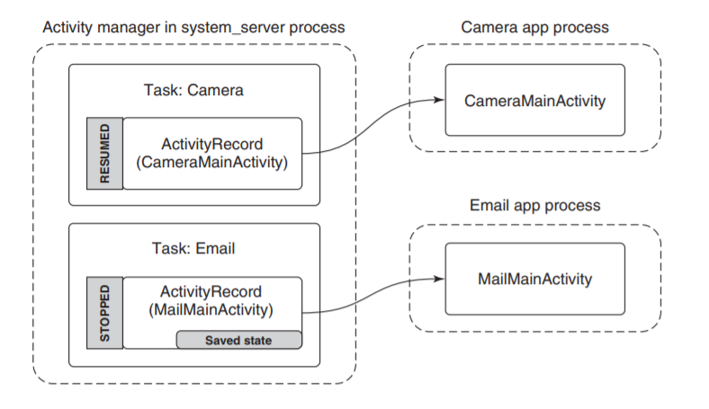
Activities
Activity is a part of the application that interacts directly with the user through a user interface
Activities are different entry points to the app; app may have many of them
When user somehow enters the app, corresponding activity’s code is run

Slide 35
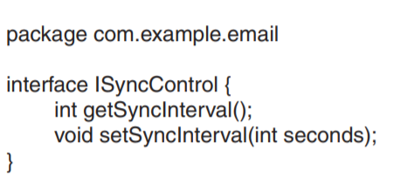
Services
Two types:
Long-running background operation (like music playing in the background)
A connection point for inter-process communication (IPC) – secure API
Type 1:
Once in a while, service starts to check email, then stops. Background service for synchronization
Type 2:
Provide interface for controlling sync interval. Other processes can bind to service app, accessing interface

Slide 36
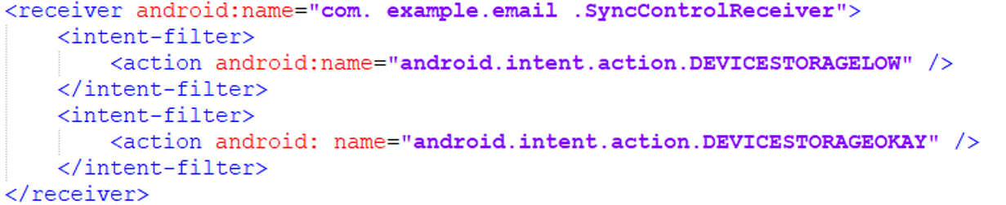
Receivers
A receiver is the background recipient of (usually external) events
Receiver allows app to detect some events without app always running
Receiver may listen to broadcasts: implicit(for anyone) and explicit (for this app exclusively)

Slide 37
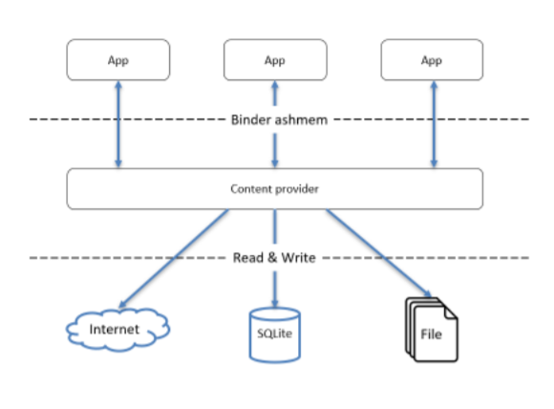
Content Providers
Content provider is the primary mechanism for exchanging data between apps
Content is accessed through URI (uniform resource identifier)
Content Resolver class handles requests for data
content://com.example.email.provider.email/messages/1 -- message with id 1 from our email app

Slide 38
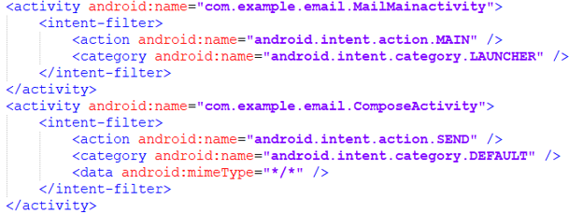
Intents
An intent is the mechanism Android uses to discover and identify activities, receivers, and services (and interact with each other)
Similar to Linux shell search, which the shell uses to look through multiple possible directories in order to find similarities.

Slide 39
Types of intents
Explicit intent – certain query to application component, including package name and class name
Implicit intent – describes characteristics of desired component, but not the component itself (search of it is called intent resolution)
Results of intent resolution:
No match – nothing or exception
Unique match – immediate action
Multiple match – which to choose? Resolver Activity – user selects it

Slide 40

Security issues

Slide 41
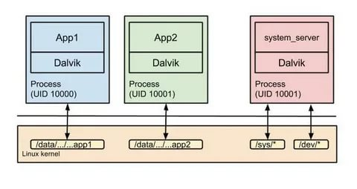
Application sandboxes
Third-party apps usually can not be trusted, so there is a way to protect the data via isolation of apps
Each app runs with its own user id, and this user’s resources and code are isolated from others
Malicious process cannot access sensitive data due to lack of privileges

Slide 42
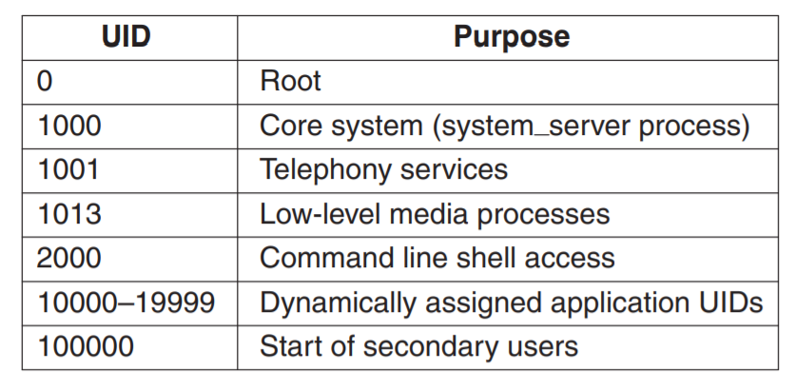
Security: UID
Application security in Android revolves around UIDs
Each process has unique ID that allow it to access limited data, preventing malicious actions
Some UID’s are static (such as root or core daemons), some are assigned in installation time
Installd daemon runs with special privileges and restricted API when creating files during installation of other app

Slide 43
Security: Example
You take picture on the camera. It’s stored in its private data space
You want to share picture via email app, which however is separate user and has no access to the picture
Application permissions exist for sharing data
They are stated in manifests and granted at installation time

Slide 44
Sources
Original slides of the adopted book and the book itself: Tanenbaum & Bos, Modern Operating Systems: 4th edition, 2013 Prentice-Hall, Inc.
Slides by Ergasheva et al., Innopolis University, Lecture 14: Structure of Operating Systems – Android.

Slide 45

Good luck!

